Slide 1
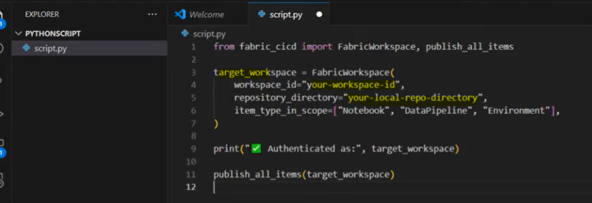
Deployement using Devops , Vscode and Python
Create a Devops account , with a repos containing a main branch
Create a dev branch from main
Clone your main branch with VS code (choose a local folder Vscode project /Fabric-cicd/)
Open a new terminal and run the following script : pip install fabric-cicd from Vscode project /Fabric-cicd/ (make it run successfully )
Create the new folder near Vscode project /Fabric-cicd/ like Vscode project /pythonSript/ and create inside a python file like script.py
The script.py contains see screenshot
From Fabric Dev WS connect to your dev branch
Create some items (notebooks , pipeline, dataflow…) and commit it to your dev branch
Do a pull request from dev to main
Refresh you local folder (Vscode project /Fabric-cicd/)) with this new changes using the script git pull origin main from VS code terminal
Now your local folder is sync with the main branch (with is sync with the dev branch)
It now time to deploy the from the main (same version as local = dev ) to Test by running the script.py from Vscode
Ref: https://www.youtube.com/watch?v=BU7JBmW4NPU

Slide 2



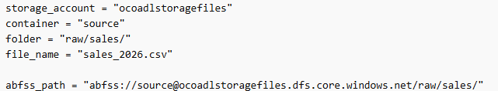
Viariable library
This is a resource in MS fabric that can be used to collect variable that need to be used in defferent environments (Dev, test, Prod)
Use case :
In a dev workspsace create de needed resources like :
Lakehouse → : workspaceID , lakehouseID , foder and Fils
Warehouse → :
Azure Database :
Databriks Unity Catalog
ADLS : example : https://ocoadlstoragefiles.blob.core.windows.net/ + folder + fileName

